Slide 1
Welcome to Nucleus
“Information is the oil of the 21st century, and analytics is the combustion engine.”

Slide 2
Motivation:
Next Generation Data & Analytics
C2 – General
2

Slide 3
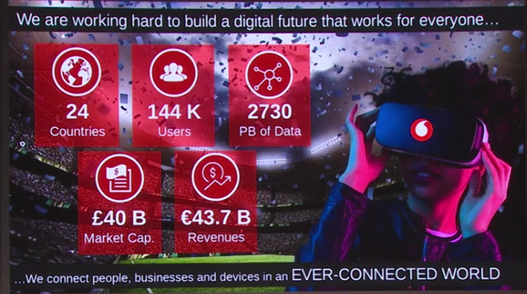
Company Overview:

Slide 4

Nucleus – Project Objective and Motivation The opportunity
High cost of storage Slow pace of change Significant duplication
Reporting on duplicated data across departments
Visualisation & Digital Collaboration
Limiting duplication Lowering cost of storage Faster change turnaround
Big Data / local data
BI products using common standards
Common tools & views on corporate data: less different flavours
Cross-market alignment around Nucleus
GOAL: Unified use, interpretation and governance of data; Shared data governance, capabilities & tooling across markets
Notes:
Cloud Analytics and cloud data storage accelerate our journey from duplicated data, via common data use & governance to shared capabilities & tooling

Slide 5
Vodafone launched Nucleus in 2019 to address a number of challenges
Cost – Data & analytics TCO is over ~200m€ / year across Vodafone with non scalable infrastructure
Significant duplication & shadow BI – Quality of BI data is inconsistent, with multiple and dispersed data warehouses per country with complex and costly data operations.
Data Driven– Limited capabilities and data inconsistencies result in diminished ability to present the relevant information and drive recommendations
Fragmented architecture – Varied DWH implementations and visualization tools, resulting in inability to leverage existing assets across markets
Localised operating models – Non-standard ways of working for creating or updating business data needs. Sometimes resulting in a slow pace of change and cost inefficiencies
C2 – General
5

Slide 6


Nucleus powers Vodafone with the foundation for next generation analytics
Ready to use analytics products
Business Self-sufficiency & Speed of Enhancements
Common data
model
Effective operating model
Advanced technology powered by Google
Standard data model tailored to Vodafone business
Modern and scalable architecture, ready for real time insights and artificial intelligence
Catalogue of products ready to be used and extended to add value to the business
Enable self-service and reuse of existing assets which drive cost efficiency and speed
Data driven insights to maintain Vodafone ahead of the competition

Slide 7
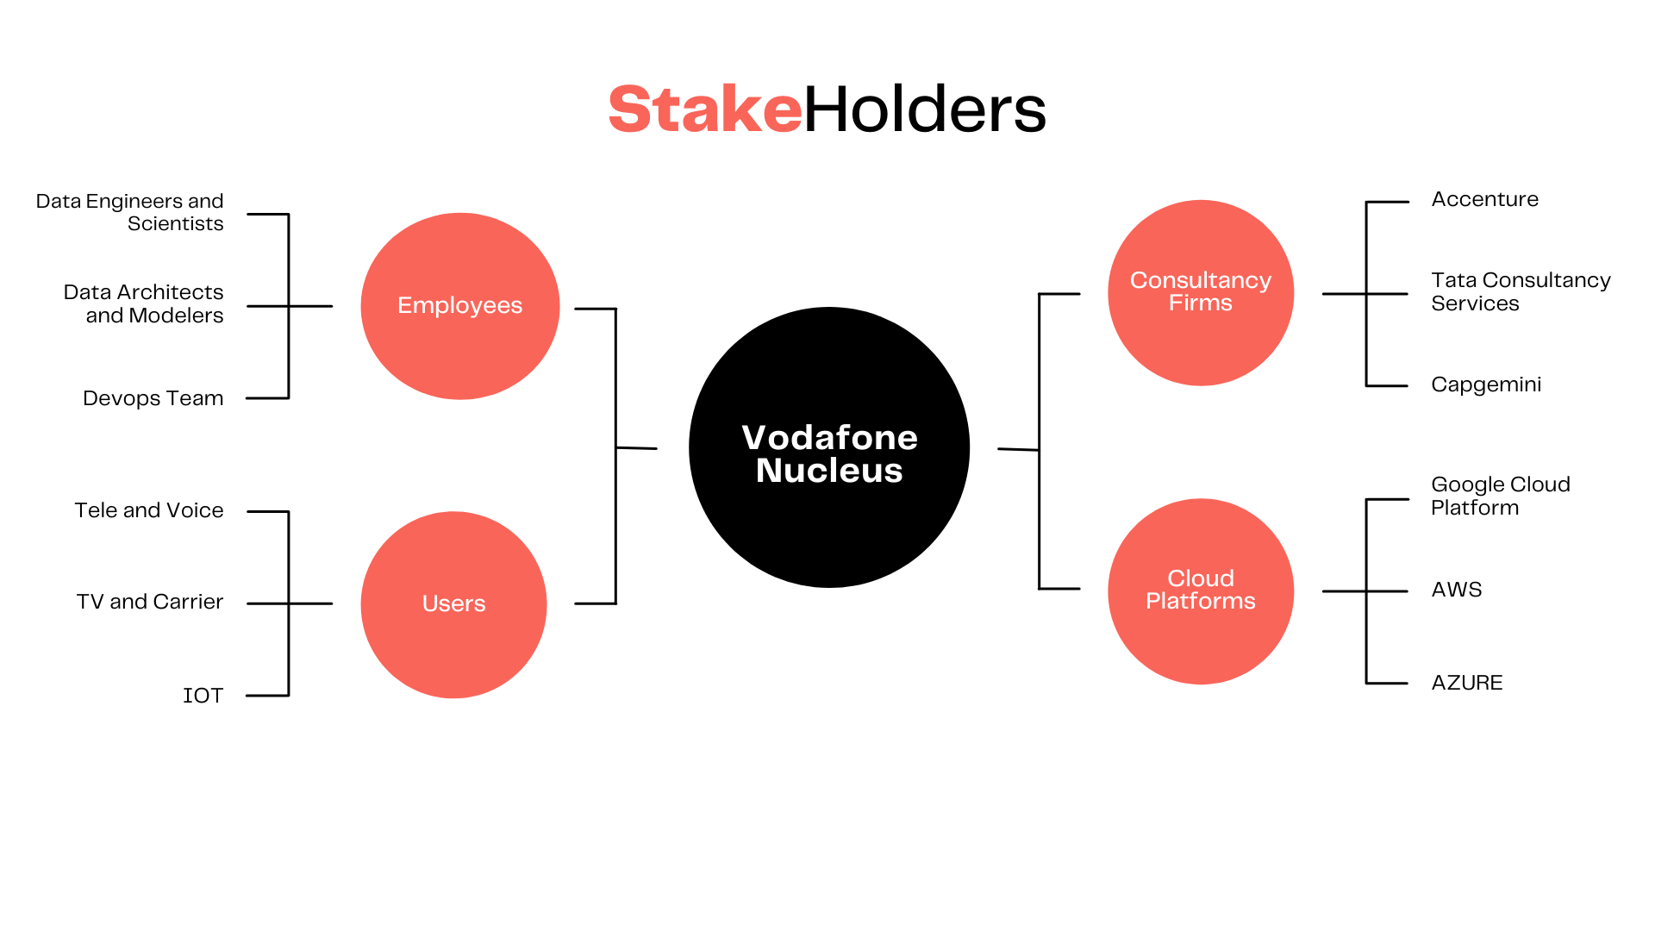

Slide 8
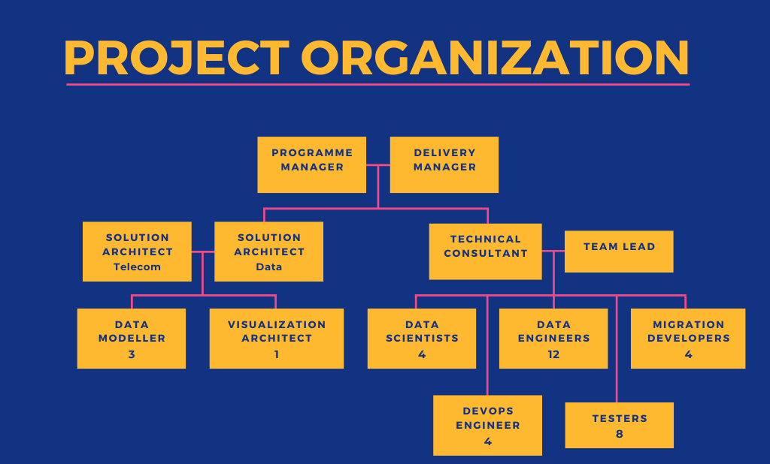

Slide 9
Nucleus Scope

Slide 10

Nucleus
Data Architecture
Local Scope
Local effort to source data into GCP and provide business rules pre-CIM
Ownership of data quality
CIM/EIM design including transformation rules from CIM to EIM
Implementation, including all test cycles and service transition to BAU
Initial set of 8 dashboards, 7 analytical models by Accn
Roadmap completion internally
Local data into cloud (DMaaP)
CIM
Local data to information (Technical Data Model)
EIM
Solutions & APIs
(BIP/Golden Source)
Solution Design and setup
Includes anonymization approach as per CDG steerco approval
Local systems
Google Cloud Platform
BI Delivery Platform
Outline of target operating model including location/ functional splits.
Target Operating Model & Organisational readiness
Decommissioning

Slide 11








Nucleus High Level Data Architecture
Local Market Infrastructure
GCP
Semantic Layer
4
1
2
3
6
EDW
Raw Cloud Storage
CIM
EIM
QlikSense
5
Step | Description
1 | Data is extracted from Local Market EDW and lands on Google Cloud Storage
2 | CIM is mapped and populated from Local Market Raw Data and definitions using Data Fusion
3 | EIM mapped and populated from CIM. Standard Metrics calculated & Stored in Fact tables
4 | Where required a Semantic Layer is built over the EIM utilising Data Fusion Processes & BigQuery views. New/Changed metrics calculated in semantic layer before being built in EIM
5 | ML Models built from data in EIM and outputs stored in Big Query
6 | QlikSense Products consume data from Model Outputs, Semantic Layer & directly from EIM

Slide 12
Project Schedule

Slide 13
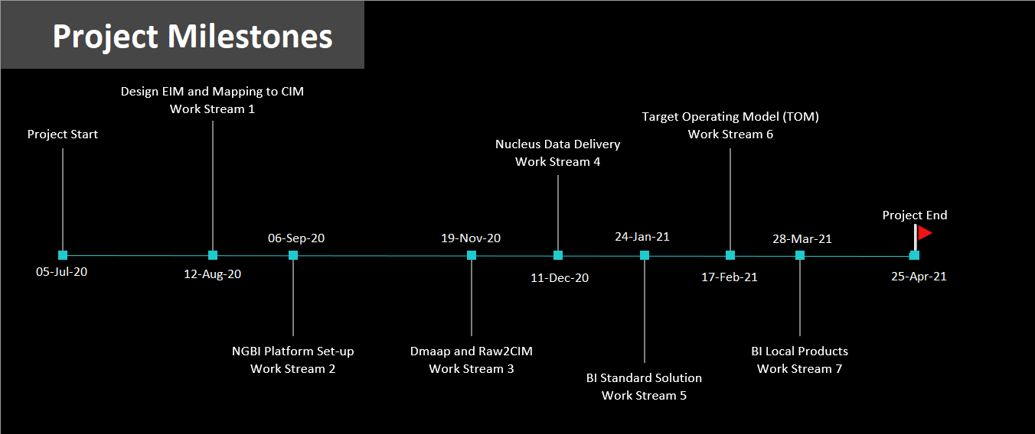

Slide 14
Nucleus Roadmap
 | 2020 | 2021 | 2022 | 2023
Rollout to markets
Portugal
Hungary
UK
Germany
Spain
Italy
Ireland
Romania
Greece
Czech Republic
Platform evolution to enhance speed, robustness and machine learning models

Slide 15
Project Budget
Estimated budget in € | Actual cost after completion in € | Difference in € | Percent increase or decrease
€ 404,999.99 | € 463,999.99 | € 59,000 | 14.5679% increase
C2 – General
15

Slide 16
Project setup

Slide 17
Nucleus Work Streams
WS 1
Design EIM and Mapping to CIM
Functional design
Conceptual and logical data model
Business transformation rules (from CIM and EIM)
WS 2
NGBI Platform Set-up
Solution architecture
Solution design principles
Platform engineering
WS 3
DMaaP and RAW2CIM
Design and implementation of data loads from source systems to data movement as a Platform (Dmaap) and GCP
WS 4
Nucleus Data Delivery
Design and delivery of data engineering on GCP
Integration points
E2E data lineage
Data quality framework
WS 5
BI Standard Solution
Insight Products
Machine Learning Models
Decommissioning
WS 6
Target Operating Model
(TOM)
Target Operating Model (TOM)
WS 7
BI Local Products
Local Products
Decommissioning
Notes:
The programme comprises 7 work streams, each focusing on a specific area of delivery

Slide 18

Raw data goes through few steps to bring business value
Raw data
Common Information Model
Enterprise Information Model
Golden Source
Raw data Source Systems
Data Lake
Information
Repository
Extraction
logic
Transformation
logic
Business
logic
Business
Information
Billing records
Billing records for Post paid customers
Customer billing information activated by Vodafone store
How many customers are unhappy with their first bill and why

Slide 19
Project Completion

Slide 20


Question | Answer
Was the project completed on time ? | The project completion was delayed by one month as initial environment setup up was a bit complicated.
Did Nucleus finish within the allocated budget ? | The Project exceeded the budget, but also laid foundations for re-usable code for other opcos.
Was the project scope satisfied ? | The Nucleus Team made an excellent effort to finish all the requirements within a short time.
Was Nucleus Successful?
How much Data Nucleus can handle ?

Slide 21
Conclusion: High level target operating model
Business Users
Insights
Demand
Jira
Business Planning
Request & Demand Management / Product Value Realisation / Product & Portfolio Management
Value Delivery
Data Delivery
Product Delivery
LM source system
Golden Source
Centrally owned
LM owned
Ingestion
Google
Provision
VOIS (GBIS)
(Build & deploy)
Group D&A
(Curate & governance)
LM D&A
RAW GCP
EIM
CIM
Transform
Transform
Platform/Service Operations
Spain Migration Service
VOIS
Google
GT
Governance & Controls
Data governance
Privacy
Governance forums
Security

Slide 22
Project Conclusion

Slide 23












The consolidation of data across markets, provides Vodafone with powerful insights across our business units
Local Market Data
Insights
Source systems
COMMON DATA PRODUCTS
Daily subscriber numbers
Data Transformation & Mapping
Golden Source
Source systems
Consumer Profitability
Insights
Enterprise Profitability
Source systems
Price plan simulation
Source systems
GCP
Churn Propensity Models
Source systems
….And more
Golden Source: Single source of truth for data
Notes:
How the data is used differently across the layers of the architecture stack

Slide 24
Lessons Learnt, opinions and recommendations

Slide 25
References
https://www.vodafone.com/news/press-release/vodafone-google-cloud-industry-first-global-data-platform
https://www.youtube.com/watch?v=rAitKERcDPU
https://analyticsindiamag.com/inside-nucleus-an-integrated-data-platform-from-vodafone-google-cloud/

Slide 26
Thank you

